Slide 1
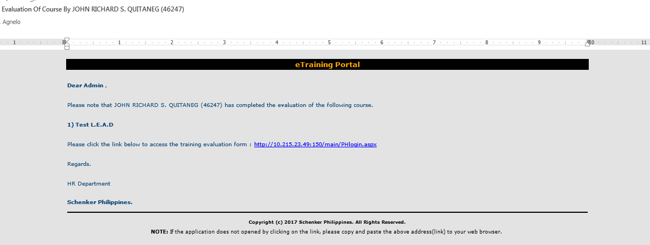
Email message: Evaluation Of Course by (name of staff & user ID)
Please edit:
Subject to be read: Training evaluation by (name of staff & user ID no.)
Please edit message body to:
Dear HR Admin,
Please be advised that (name of staff) has completed Training Evaluation Form of the following course: (name of course).
Please click the link below to access the form: (name of link).
Best regards,
HR Department
Schenker Philippines, Inc.

Slide 2
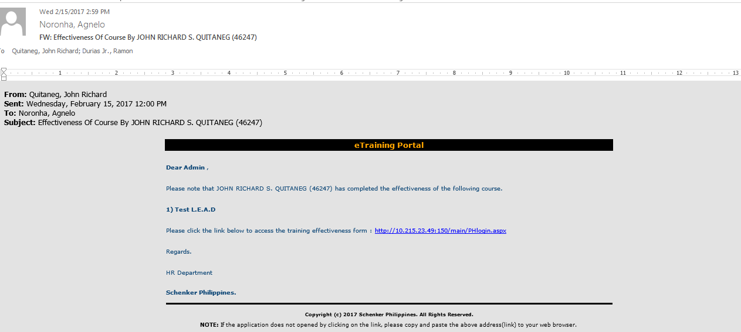
Email message: Effectiveness of Course by (name of staff & userID)
To clarify: this email on training effectiveness should be completed by the L1 for the staff who completed a particular course.
Please edit Subject to Training Effectiveness Form Completed by (name of manager for name of staff)
Please edit Email body to:
Dear HR Admin,
Please be advised that (name of L1) has completed the Training Effectiveness Form for (name of staff) for the following course (name of course):
Please click the link below to access the form: (name of link)
Best regards,
HR Department
Schenker Philippines, Inc.

Slide 3
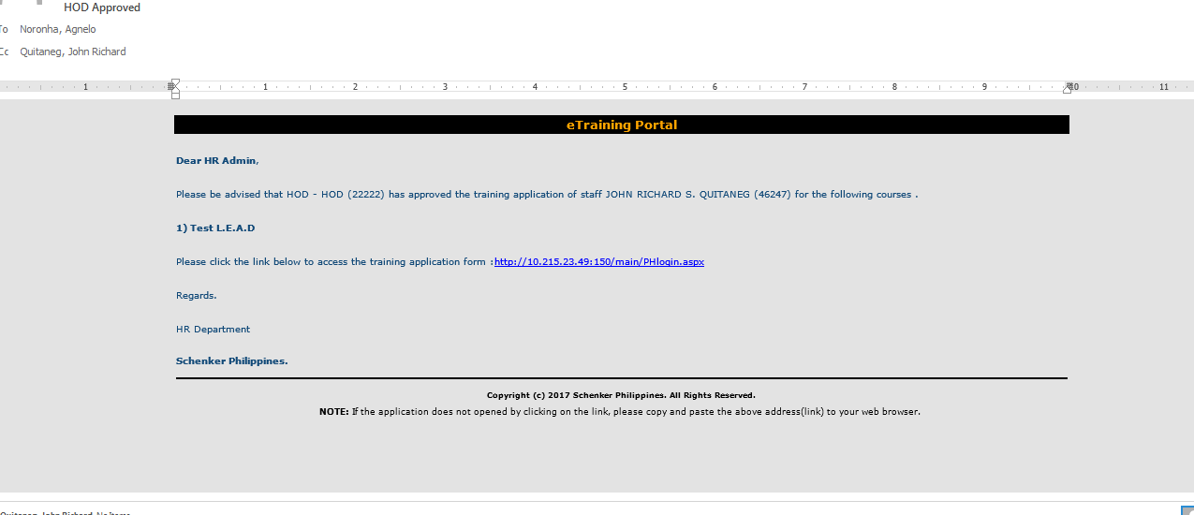
Email message: HOD Approved
Please edit Subject to Training approved by HOD
Please edit Email body to:
Please be advised that (name of HOD) has approved the training application of (name of staff) for the following course (name of course):
Please click the link below to access the form: (name of link)
Best regards,
HR Department
Schenker Philippines, Inc.

Slide 4
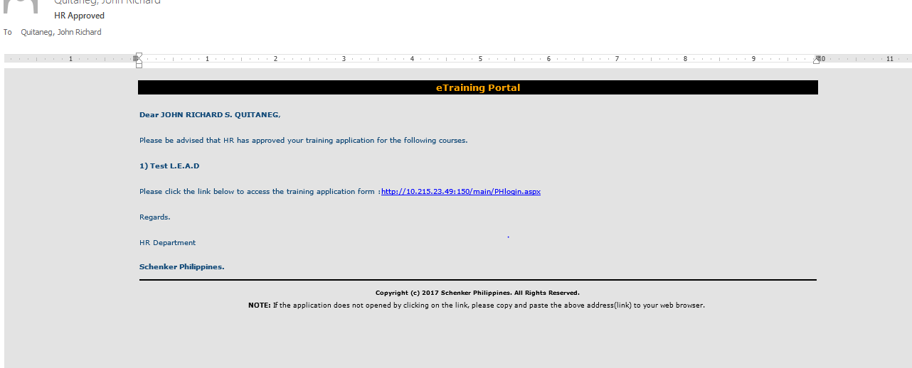
Email message: HR Approved
Please edit Subject to HR Closes Training Application
Please edit Email body to:
Dear (Name of staff),
Please be advised that HR has closed the training application for the following course (name of course):
Please click the link below to access the form: (name of link)
Best regards,
HR Department
Schenker Philippines, Inc.

Slide 5
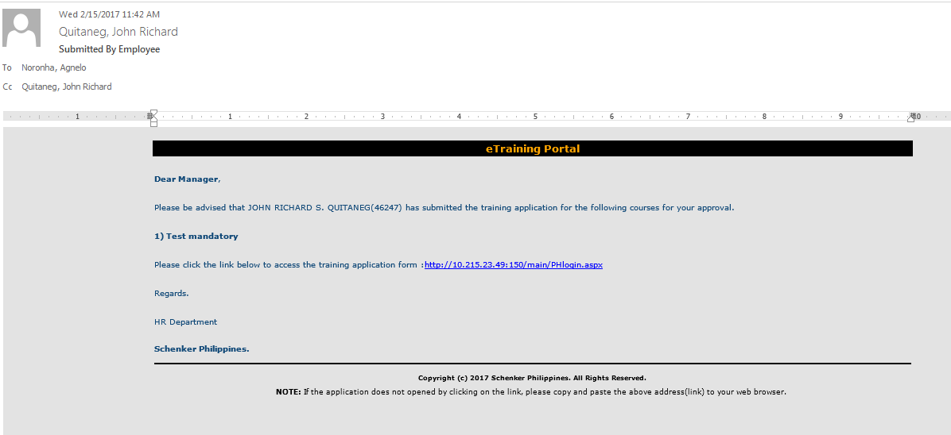
Email message: Submitted by Employee
Please edit Subject to Training Application submitted by Employee
Please edit Email body to:
Please be advised that (name of employee) has submitted the training application for the following course. For your approval.
(name of course).
Please click the link below to access the form: (name of link)
Best regards,
HR Department
Schenker Philippines, Inc.

